Slide 1
MSE 311: Thermodynamics of Materials
Lecture 10-11: Behavior of gases
Weishu Liu
Department of Materials Science and Engineering
Southern University of Science and Technology (SUSTech)
Email: liuws@sustech.edu.cn
Office: North Tower, Rm. 310

Slide 2
The isotopic composition of lead in atomic percent is as following
Calculate the molar configurational entropy of leady
Atomic weight
Atomic percentage
204
206
207
208
1.5 %
23.6%
22.6%
52.3%

Slide 3
23. The equation of state for real gas
Ref. Introduction of Thermodynamics of Materials, D. R. Gaskell, Chapter 8

Slide 4

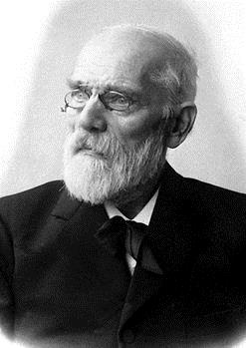

Equations of State
For idea gases
Two assumption for idea gas
1). The volume of the molecular is negligible
2). The attractive and repulsive for are negligible
Johannes Diderik van der Waals
Dutch, physicist
1910, Nobel Prize
For real gases
Prize motivation: "for his work on the equation of state for gases and liquids"

Slide 5
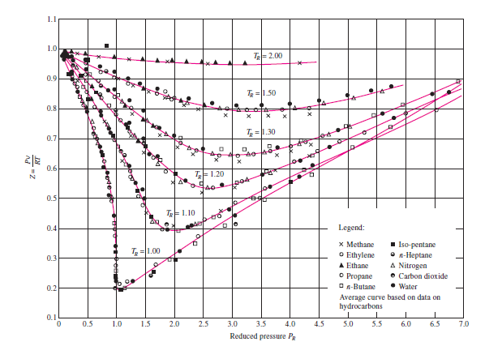


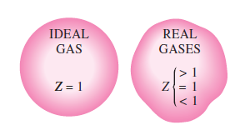
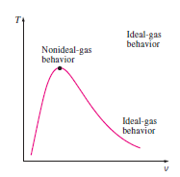
Equations of State for the non idea gas
Comparison of Z factor for various gas
Compressibility factor
The deviation of a gas from idea gas behavior in greatest in the vicinity of the critical point

Slide 6
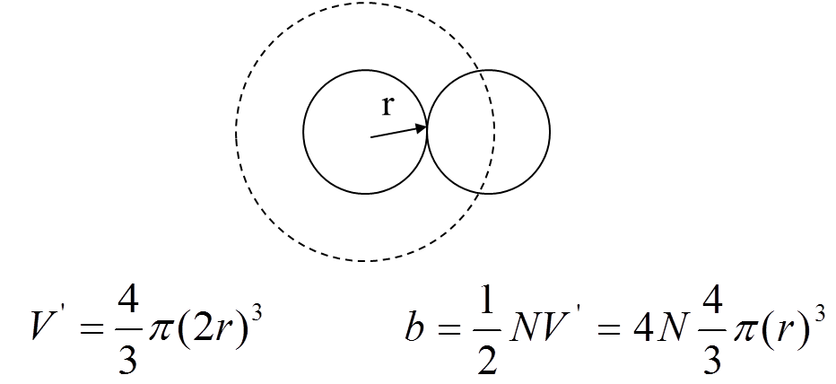
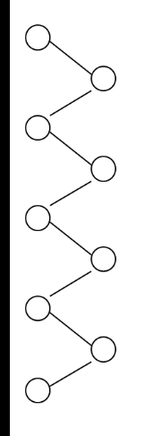
van der Waals equation of gas
Idea gas : no volume & no interaction
Real gas: finite volume & interaction
1. Volume modification
2. Pressure modification
* Only consider the repulsive force
Internal pressure P_{i}
van der Waals equation:

Slide 7

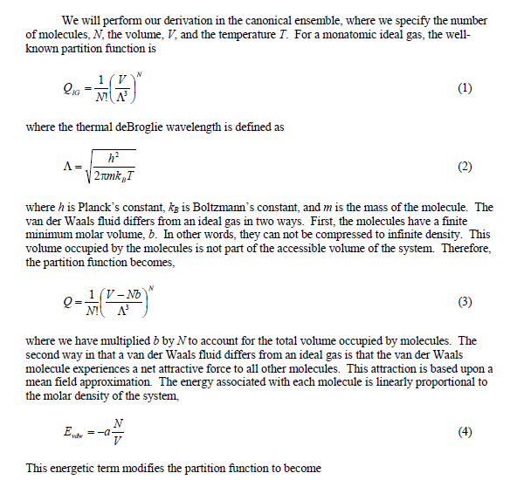
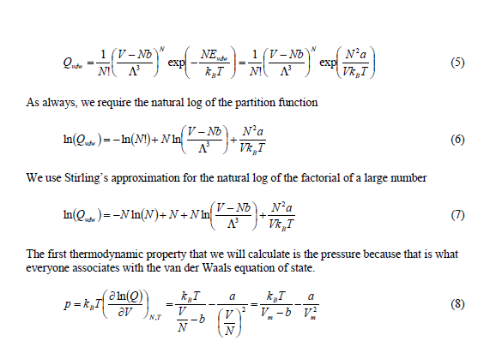
van der Waals equation
David Keffer, Univ. of Tennessee

Slide 8
van der Waals equation
van der Waals equation for 1 mol gas:
van der Waals equation for n mol gas:
van der Waals equation for gas-i of a mixture
Notes:
15级杨小炜指出

Slide 9
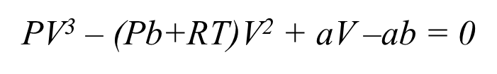
Critical Point
There are minimum and maximum points
Increasing T, two points approach each other
At critical T, two points coincide and produce a horizontal in flexion

Slide 10
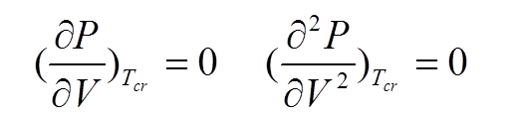
Critical Point
The critical point:
Normalized parameters:

Slide 11
Law of corresponding state
For a given gas
it has one critical point and there characterized parameter, P_{cr,} T_{cr,} v_{cr}
Normalized parameters: P_{R}, T_{R}, v_{R}
Van der Waals reduced equation of state
Law of corresponding states:
all gases obey the same equation of the state when expressed in terms of the reduced variables
OQ: for a 2D gas, or 1D gas?

Slide 12
https://arxiv.org/pdf/1106.1273
How their Van der Waals reduced equation of state??

Slide 13
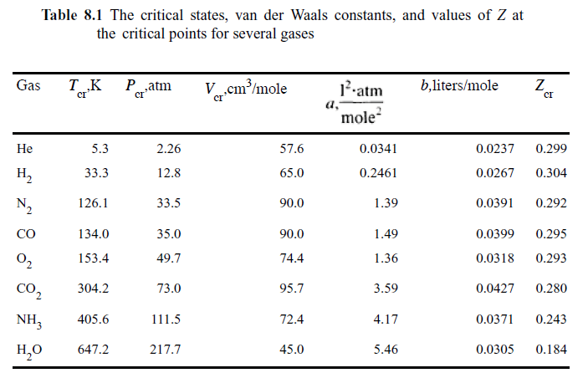
van der Waals constant

Slide 14
Nobel Lecture Note
1873, van der Waals wrote his thesis, entitled Over de Continuïteit van den Gas- en Vloeistoftoestand (On the continuity of the gas and liquid state)
1874, J. C. Maxwell, "Van der Waals on the Continuity of Gaseous and Liquid States". Nature. 10 (259): 477–480
...It will be perfectly clear that in all my studies I was quite convinced of the real existence of molecules, that I never regarded them as a figment of my imagination, nor even as mere centres of force effects. I considered them to be the actual bodies, thus what we term "body" in daily speech ought better to be called "pseudo body". It is an aggregate of bodies and empty space. We do not know the nature of a molecule consisting of a single chemical atom. It would be premature to seek to answer this question but to admit this ignorance in no way impairs the belief in its real existence. When I began my studies I had the feeling that I was almost alone in holding that view. And when, as occurred already in my 1873 treatise, I determined their number in one gram-mol, their size and the nature of their action, I was strengthened in my opinion, yet still there often arose within me the question whether in the final analysis a molecule is a figment of the imagination and the entire molecular theory too. And now I do not think it any exaggeration to state that the real existence of molecules is universally assumed by physicists. Many of those who opposed it most have ultimately been won over, and my theory may have been a contributory factor. And precisely this, I feel, is a step forward. Anyone acquainted with the writings of Boltzmann and Willard Gibbs will admit that physicists carrying great authority believe that the complex phenomena of the heat theory can only be interpreted in this way. It is a great pleasure for me that an increasing number of younger physicists find the inspiration for their work in studies and contemplations of the molecular theory..
— Johannes D. van der Waals's notes
in Nobel Lecture, The equation of state for gases and liquids (12 December 1910).

Slide 15
The van der Waals Gas
Intrinsic stable condition:
JIHGF line violated this condition!!!

Slide 16
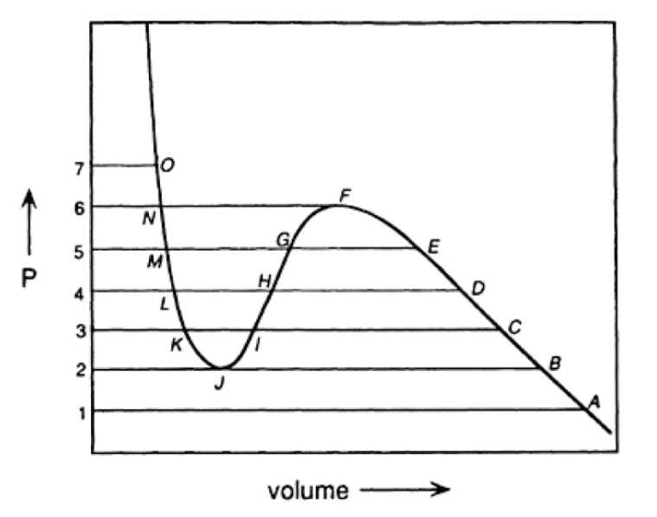
Maxwell construction
Prof. W.S. Liu | 16

Slide 17
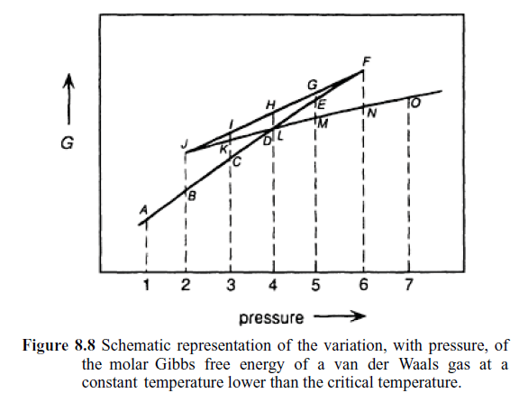
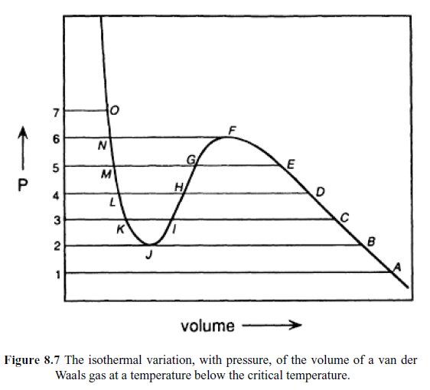
Maxwell construction
Lines DF and LJ represent the metastable vapor and metastable liquid states.
In the absence of nucleation of the liquid phase from the vapor phase at the state D, supersaturated vapor would exist along the line DEF.
In the absence of nucleation of the vapor phase from the liquid phase at the state L, supersaturated liquid would exist along the line LKJ.

Slide 18
Spinodal points
stable
Pressure, P
metastable
unstable
metastable
Volume, V
J and F are the spinodal point
represents the limit of metastability of the vapor and liquid

Slide 19
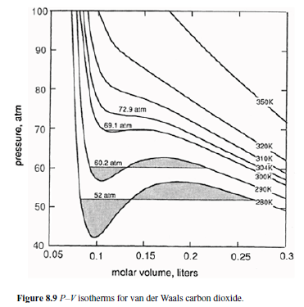
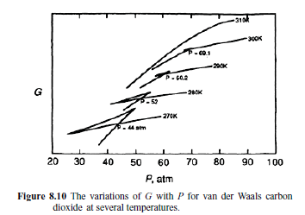
Maxwell construction

Slide 20
latent heat of van der Waals Gas
Latent heat of Evaporation from liquid to vapor
Maxwell equations
Latent heat of Evaporation rapidly falls to zero when the temperature approaches to T_{cr}
van der Waals Gas

Slide 21
Redlich-Kwong Equation of State (1949)
van der Waals equation
Redlich-Kwong Equation
Home work:
derive the reduced equation of state for the Pedlich-Kwong’s equation

Slide 22
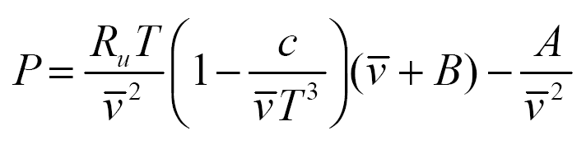
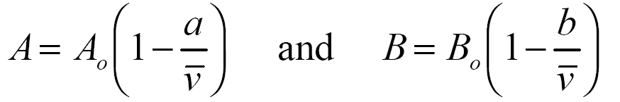
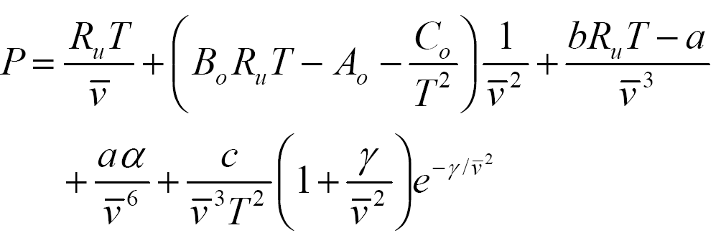
Other Equations of State for the Vapor
Beattie-Bridgeman:
where
The constants a, b, c, A_{o}, Bo for various substances are found in Table 3-4.
Benedict-Webb-Rubin:

Slide 23
Viral Equations of State for the Vapor
Idea equation of state
Viral equation of state

Slide 24
Condensed Phase
Solids and liquids have particles that are fairly close to one another, and are thus called " condensed phases " to distinguish them from gases
Redlich-Kwong Equation
It could gives give good result at elevated pressure and low temperature at which the gas tends to be as dense as liquid
Empirical Equation
Compressibility

Slide 25
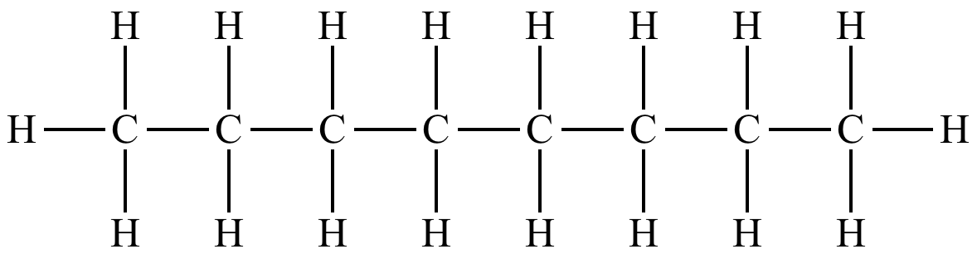
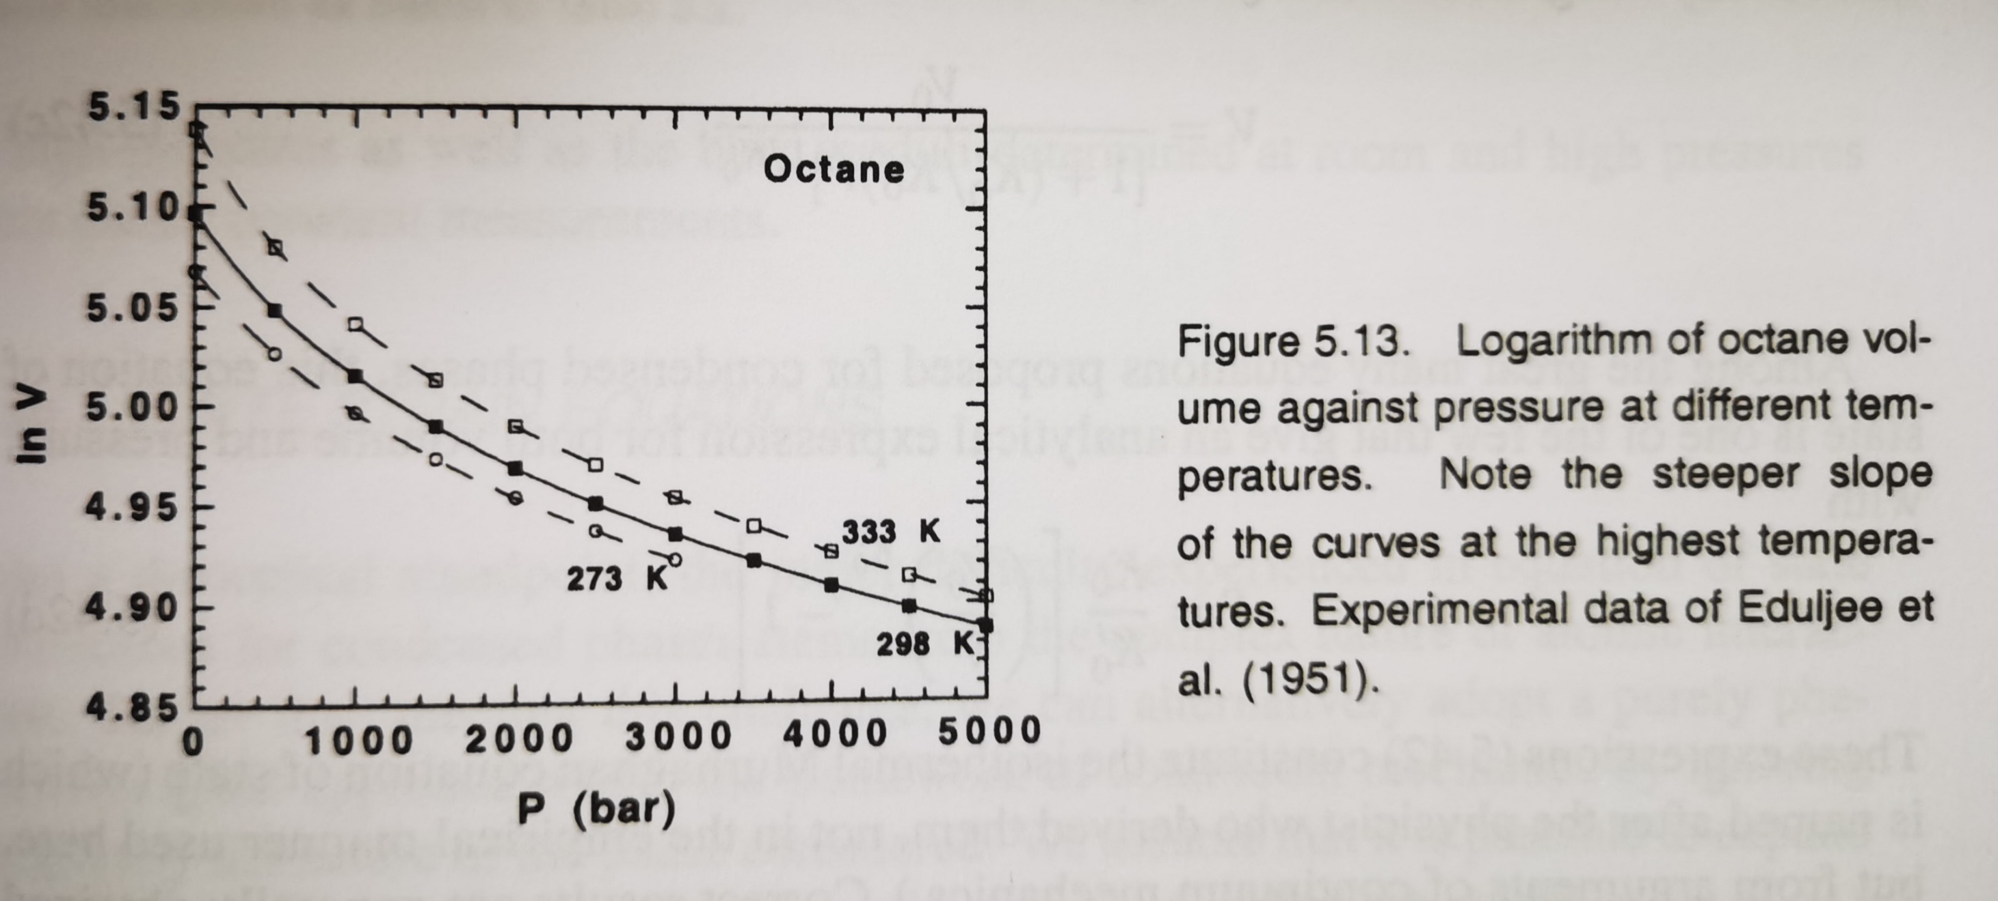
辛烷
Octane

Slide 26
24. Water Phase diagram
Ref. Introduction of Thermodynamics of Materials, D. R. Gaskell, Chapter 7

Slide 27
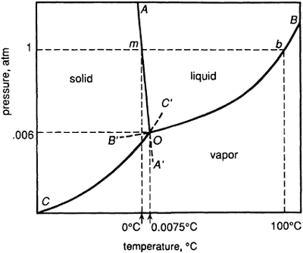



Water Phase diagram
AOA’: Solid-Liquid equilibrium line
Clapeyron eq.
BOB’: Liquid-vapor equilibrium line
Clausius-Clapeyron eq.
COC’: Solid-Vapor equilibrium line
Schematic representation of part of the phase diagram for H₂O
Clausius-Clapeyron eq.
triple point O: Solid, Liquid, Vapor are in equilibrium each other.
Metastable state: OA’, OB’ and OC’

Slide 28
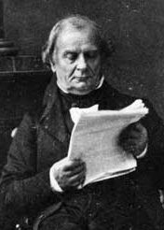
Clapeyron equation:
S-L equilibrium
The condition for the Solid-Liquid equilibrium
ΔG=G^{S}–G^{L}=0
At the equilibrium
Benoît P. É. Clapeyron
(1799-1864)
Clapeyron equation is a relationships between the variations of temperature and pressure which are required for the maintenance of equilibrium between the two phases

Slide 29
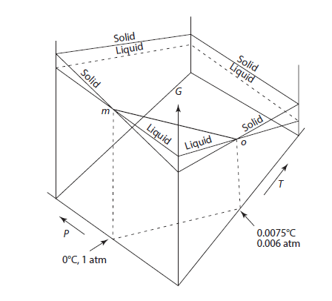
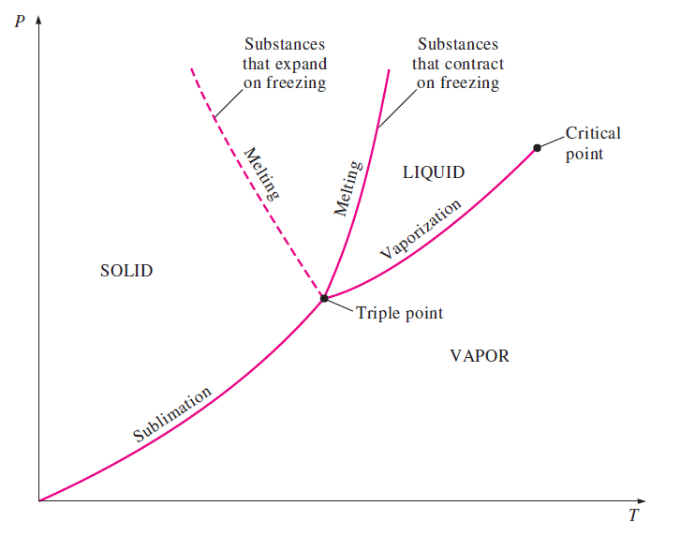
Clapeyron equation:
Solid-Liquid equilibrium
When thermal energy is added to the system
It causes the solid to melt and Δ H _{( S → L )} > 0 (endothermic).
The sign of (dP/dT)_{eq} is thus determined by the sign of Δ V _{( S → L )}
Water: V_{L} < V_{S} , Δ V _{( S → L )} <0, dP/dT <0
Normal liquid: V_{L}>V_{S} , Δ V _{( S → L )} >0, dP/dT >0
water
Normal liquid

Slide 30


Clausius-Clapeyron equation:
Vapor-condense phase equilibrium
∆V is the change in the molar volume accompanying evaporation or sublimation
∆H is the corresponding change in the molar enthalpy, i.e., the molar latent heat of evaporation or sublimation
Δ V = V ^{vapor} – V ^{condensed phase}
If it is further assumed that the vapor in equilibrium with the condensed phase behaves ideally, i.e., PV=RT
Δ V ~ V ^{vapor}
Clausius-Clapeyron equation

Slide 31



Clausius-Clapeyron equation:
Vapor-condense phase equilibrium
Clausius-Clapeyron equation
1. If ∆H is independent of temperature
i.e. C_{p}(vapor)= C_{p}(condensed phase),
and integrate
2. If ∆H is temperature dependent
i.e. C_{p}(vapor)≠C_{p}(condensed phase),

Slide 32
25. High pressure phase diagram
Acknowledgement to Prof. Shan Ming Wang, Phys. SUSTech

Slide 33
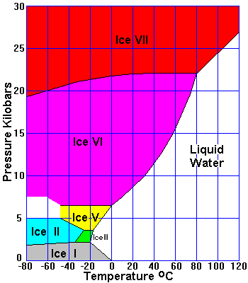
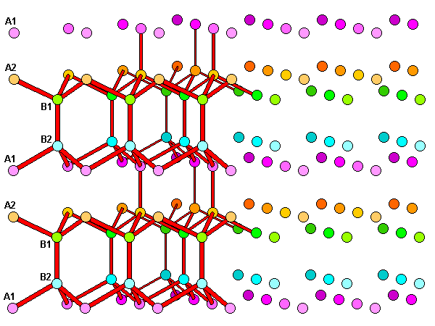
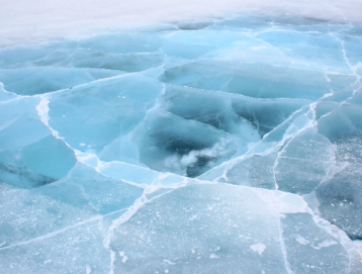
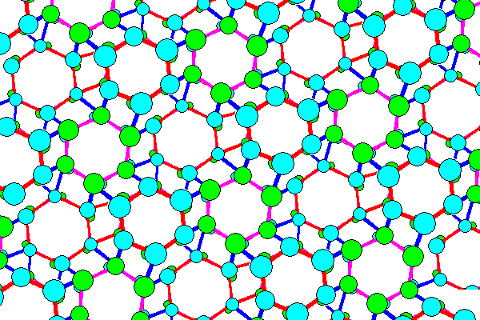
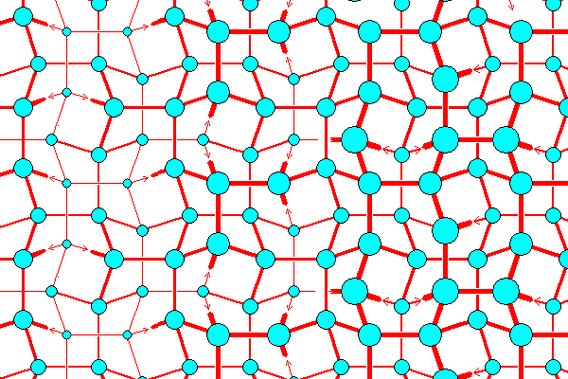
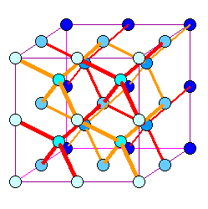
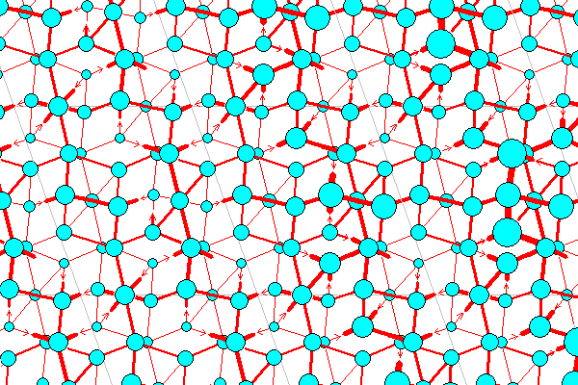
Phase diagram of H₂O at high-P
Ice(I)
Ice(II)
Ice(III)
Ice(V)
Ice(VII)
https://www.uwgb.edu/dutchs/Petrology/Ice%20Structure.HTM

Slide 34
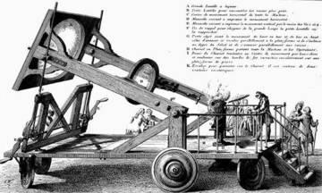
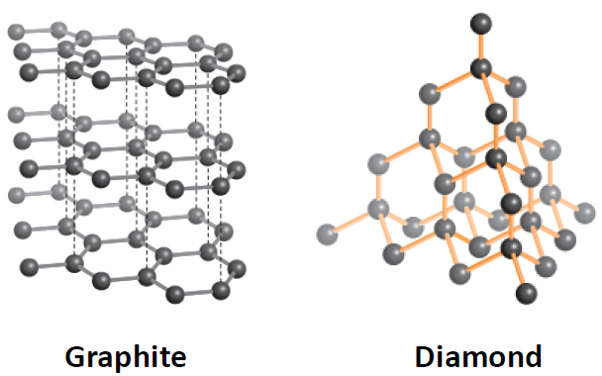
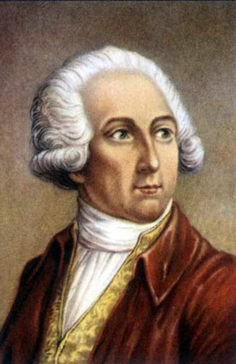
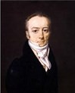
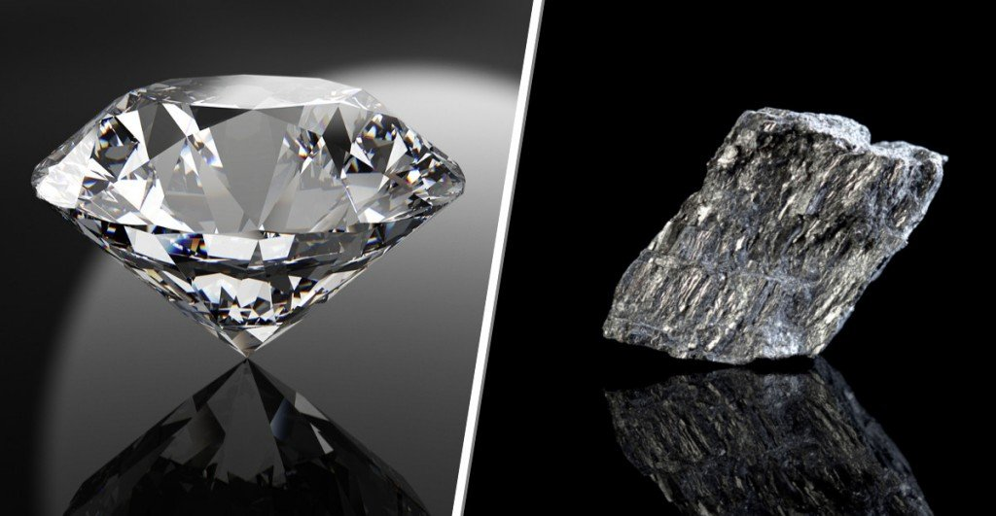
Synthetic diamonds
1772, Lavoisier
Antoine Lavoisier
1743-1794
Smithson Tennant
father of modern chemistry

Slide 35
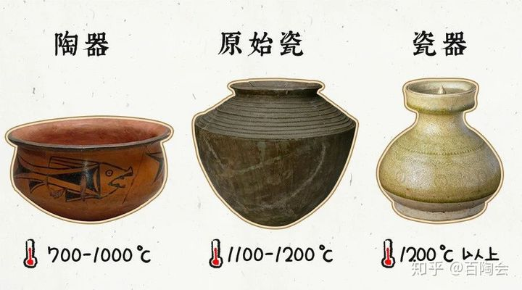
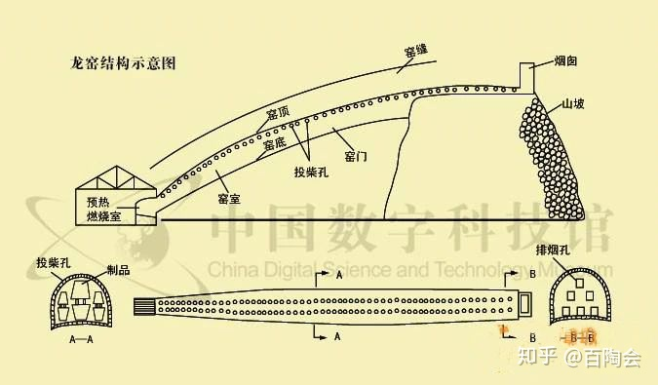
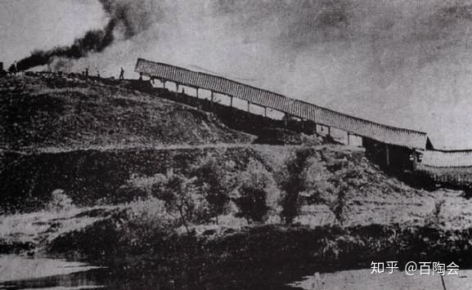
始建于明代，历代多次翻新修葺，窑道长43.4米，内底宽2.3米，高1.55米。窑身设投柴孔（俗称麟眼洞）42对，右侧有壶口（窑门）5个，燃料主要为煤、松、竹枝等，产品以罐、瓮、盆等粗陶为主，烧成温度1150℃

Slide 36
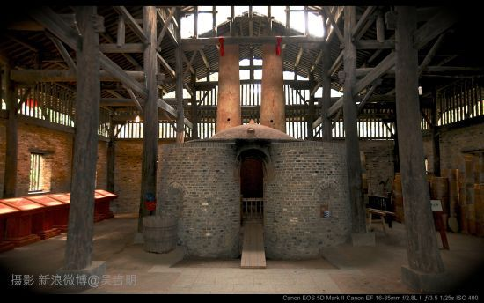
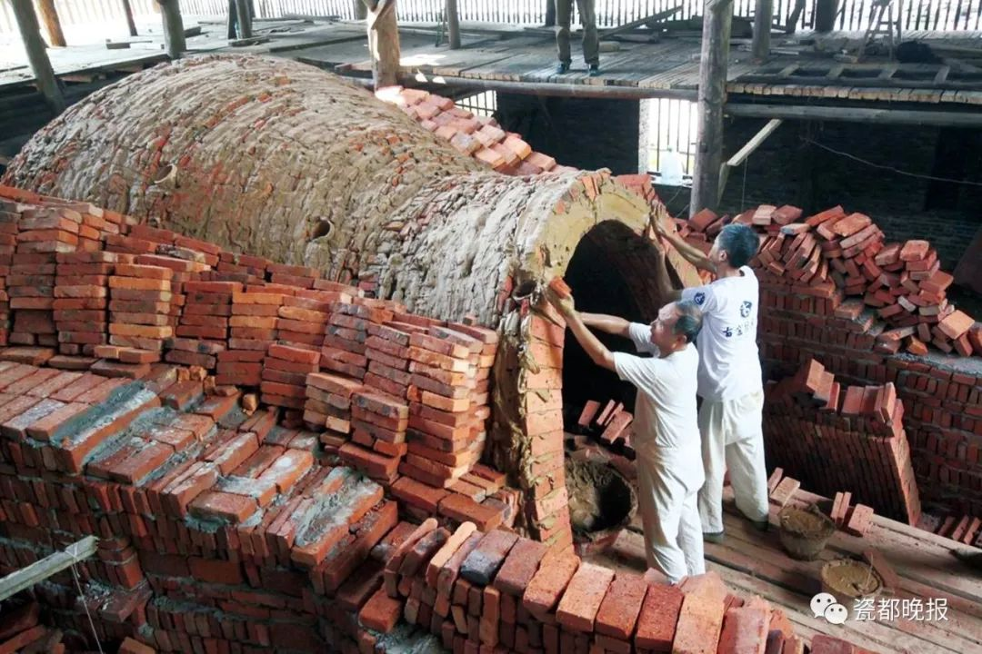

Slide 37
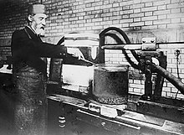
Synthetic diamonds
1893, Moissan claimed he create synthetic diamonds using an electric arc furnace
1906 Nobel Prize in Chemistry for his work in isolating fluorine from its compounds
1907, Moissan die in Paris
Henri Moissan, 1852-1907
The first synthetic diamonds are proved fake !!!

Slide 38
Calculate the pressure
to obtain the diamond from graphite at 298K
The volume change for the phase transition
For the transformation from graphite to diamond, at P=1, T=298K
Calculate the pressure at the equilibrium condition, P and T= 298
The relationship between ΔG and P

Slide 39

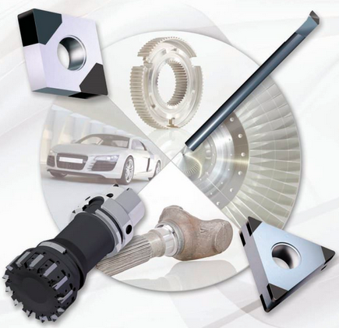

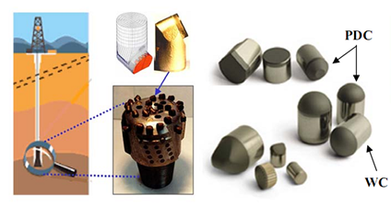
Synthetic diamonds
1941, General Electric changed the history of synthetic diamonds
HPHT (High Pressure High Temperature) process.
They placed a combination of metal and carbon into a chamber , then applied over a million pounds of pressure per square inch at a temperature of over 2,700 degrees celsius! The process took about 20 minutes

Slide 40
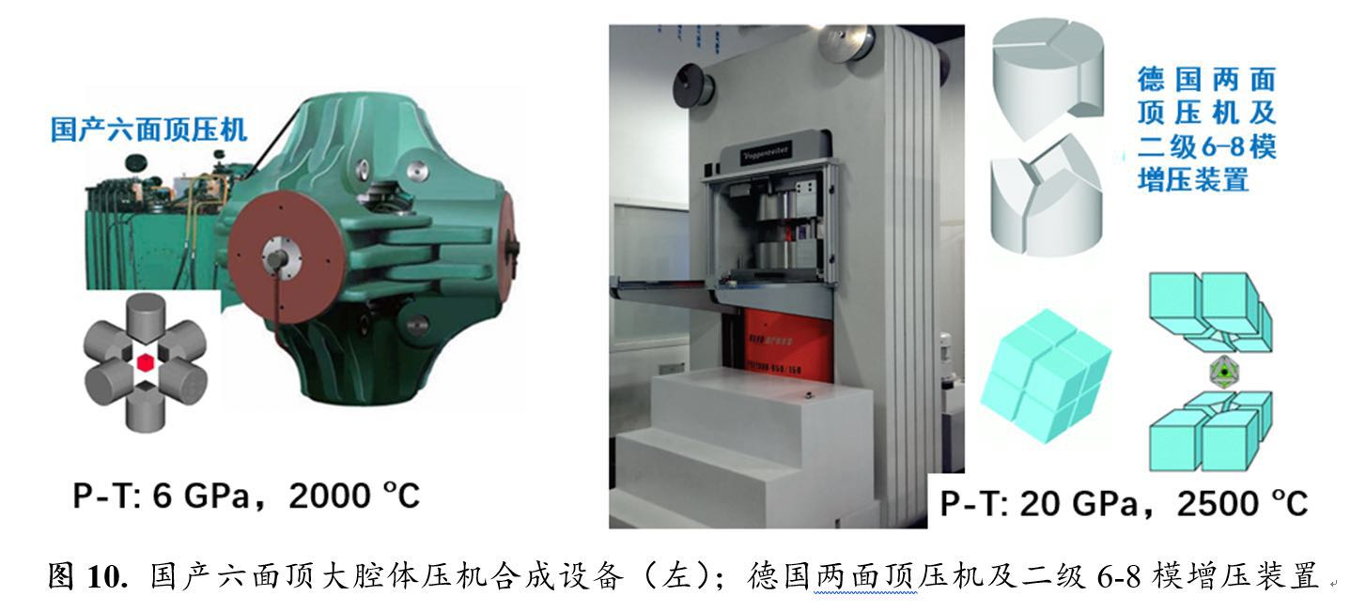
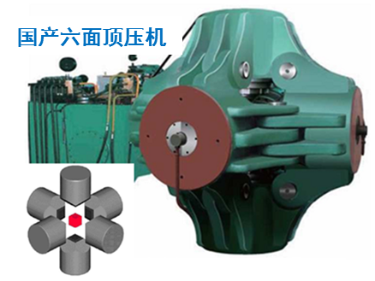
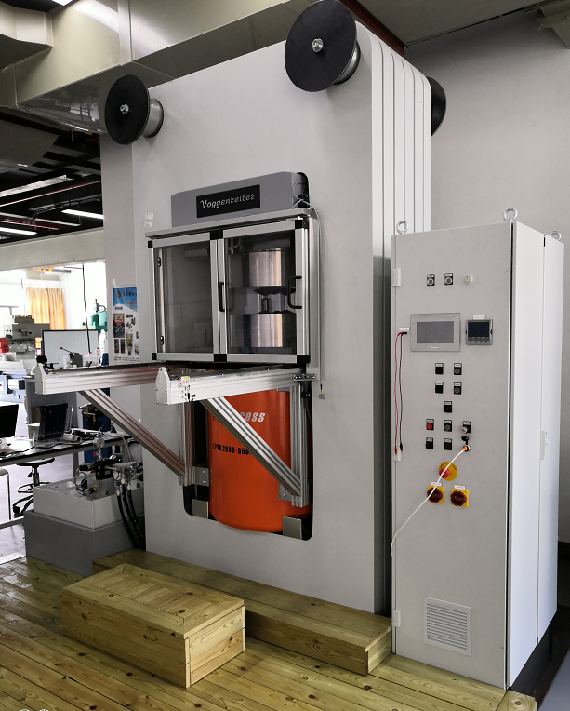
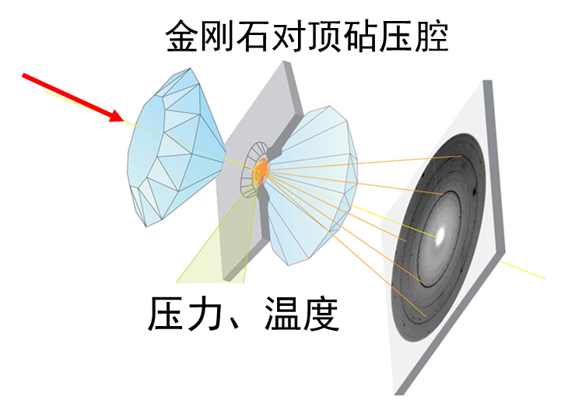
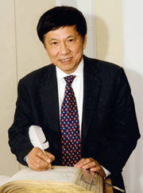
Pressure in the lab
P-T: 7 GPa, 3000 K, 厘米级腔体
P-T: 20 GPa, 2700 K, 毫米级腔体
XRD, IR, Raman…
P-T: >100 GPa, 1.5 - 4000 K
1976年，与P.M.Bell合作改进的金刚石压腔可达100GPa，第一次观察到金刚石损坏的新形式－塑性流动，
1978年，提高到173GPa，即相当于地球外核的压力。
1986年，与徐济安、P.M.Bell合作创造了550GPa的世界最高静压力的纪录（已超过地心的压力）

Slide 41





Slide 42




Slide 43



Slide 44



Gas clathrate hydrate

Slide 45
26. The behavior of gas mixture
Ref. Introduction of Thermodynamics of Materials,
D. R. Gaskell, Chapter 8

Slide 46
Idea gas mixtures
For a closed system of a fixed composition at constant temperature
Gibbs free energy has no absolute value, only the change can be measured
An arbitrary reference state is chosen as the standard state
Standard state: 1 mol of pure gas at 1 atm pressure and the temperature of interest, Gibbs free energy designed as Gº (T)

Slide 47

Idea gas mixtures
Mole fraction
For a system having n_{A} mol A, n_{B} mol B and n_{c} mol C
Dalton’s law of partial pressures
John Dalton
British Physictist
1766-1844
Notes:
John Dalton is teacher of James Prescott Joule

Slide 48

Partial molar quantities
Partial molar quantities
The molar value of any extensive state property of a component of a mixture is called the partial molar value of the property.
This value is not necessarily equal to the value of the molar property of the pure component.
The partial molar value of an extensive property Q of the component i in a mixture of components i, j, k,…is formally defined as
If 1 mole of i is added, at constant temperature and pressure, to a quantity of mixture which is sufficiently large that the addition causes virtually no change in the composition of the mixture, the consequent increase in the value of Q’ equals the value of $\overline{Q}i$ in the mixture

Slide 49

Partial molar quantities
In case of the extensive property being the Gibbs free energy
The relationships among the various state functions developed in the preceding chapters are applicable to the partial molar properties of the components of a system
fixed composition and const. T

Slide 50

Partial molar quantities
Partial molar V
The rate of change V with respect to the n_{A}
Partial Pressure

Slide 51


Enthalpy of idea gas mixing
Gibbs-Helmholtz Equation
The partial molar enthalpy of ideal gas i in a mixture of ideal gases
equals the molar enthalpy of pure i
the enthalpy of the gas mixture equals the sum of the enthalpies of the component gases before mixing.
This is a result of the fact that the idea gas don’t react with one another!

Slide 52

Gibbs free energy of idea gas mixing
If all gases have the same pressure before mixing, P₁ = P₂ = …= P,
and the mixing is at total constant volume such that the total pressure of the mixture, P_{mix}, equals the initial pressures of the gases before mixing, then, as p_{i} / P_{i} =X_{i}

Slide 53
Entropy of idea gas mixing
The mixing entropy ΔS^{mix} is positive
The mixing of idea gas is spontaneous
Any interaction among the particles of the gas would decrease the entropy of the mixing

Slide 54
27. The behavior of non-idea gas mixture
Ref. Introduction of Thermodynamics of Materials, D. R. Gaskell, Chapter 8

Slide 55
real gas mixtures
Idea gas mixture : the molar Gibbs free energy of an ideal gas is a linear function of the logarithm of the pressure of the gas
Real gas mixture : the molar Gibbs free energy of an ideal gas is not a linear function of the logarithm of the pressure of the gas
People define a new function fugacity f, in place of P, to keep the linear relationship
for standard state: f=1, T
When P→0, f→P

Slide 56
Real gas mixtures
Virial equation state
First order correction:
where α is a function only of temperature and is a measure of the deviation of the gas from ideality

Slide 57
Real gas mixtures
Integration between P=P and P=0
as P=0, we have f=P
the real gas is close to idea,

Slide 58

Real gas mixtures
α/RT=0.005
Idea gas
Non-idea gas

Slide 59
Real gas mixtures
Virial equation state

Slide 60
Gibbs free energy of real gas mixture
Nitrogen gas at ºC

Slide 61
Molar Gibbs free energy of an non-idea gas
For the change of state of 1 mole of gas from (P₁, T) to (P₂, T)
If the gas is idea
Non idea
Idea

Slide 62
Example-1
A virial equation of state for n-butane at 460 K,
Z=1+A/V+B/V², in which A=-265 cm³/g, and B=30,250 cm⁶ /g.mol². calculate the change in the Gibbs free energy when the volume of 1 mol of n-butane is decreased from 400 to 200 cm³ at 400K.
1. The equation of the state
2. The change of the Gibbs free energy

Slide 63


Example-2

Slide 64

real gas mixtures

Slide 65
Example
Comparation of the work in a reversible isothermal expansion
from P₁= 100 atm; P₂= 50 atm;
1 mol hydrogen gas following: PV=RT (1+0.0064P)
1 mol idea gas following: PV=RT
1. At initial pressure P₁=100 atm
3. Isothermal expansion
2. At final pressure P₂=50 atm
3. Isothermal expansion

Slide 66


Why at the isothermal expansion ?
We have the work done by non-idea gas is larger than idea gas?
Open question: In the Otto cycles, whether we get a similar conclusion
“the efficiency by using non-idea gas is larger than idea gas”
k=C_{p}/C_{v}
k = 1.667 (Ar or He)
k = 1.3 (CO₂)
k = 1.2 (CH₃CH₃)

